Slide 1
Modulation of Movement by the Basal Ganglia
By: Nicole Phillips

Slide 2
Learning objectives
Identify the structures that comprise the basal ganglia and their basic interconnections
Describe the mechanism of disinhibition and how it is important for basal ganglia function
Compare functions of the direct and indirect pathways of information flow through the basal ganglia
Relate how impairment of the basal ganglia may lead to motor and non-motor symptoms of different disorders

Slide 3
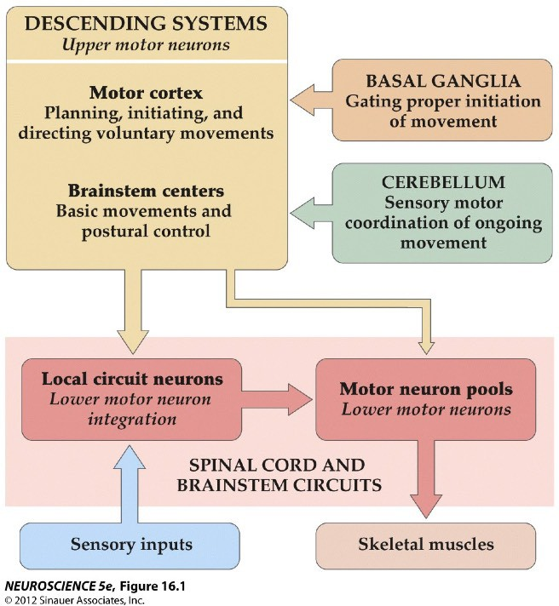
Four Neural Centers for Movement
3
Upper Motor Neurons (UMNs)
Top-down control of movement
2
Modulation of motor plans
4
1
Lower motor neurons (LMNs)
“Final common path” for initiating movement

Slide 4
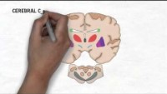
https://nba.uth.tmc.edu/neuroscience/m/s3/chapter04.html#:~:text=As%20mentioned%20earlier%2C%20there%20are,their%20role%20in%20motor%20control.

Slide 5
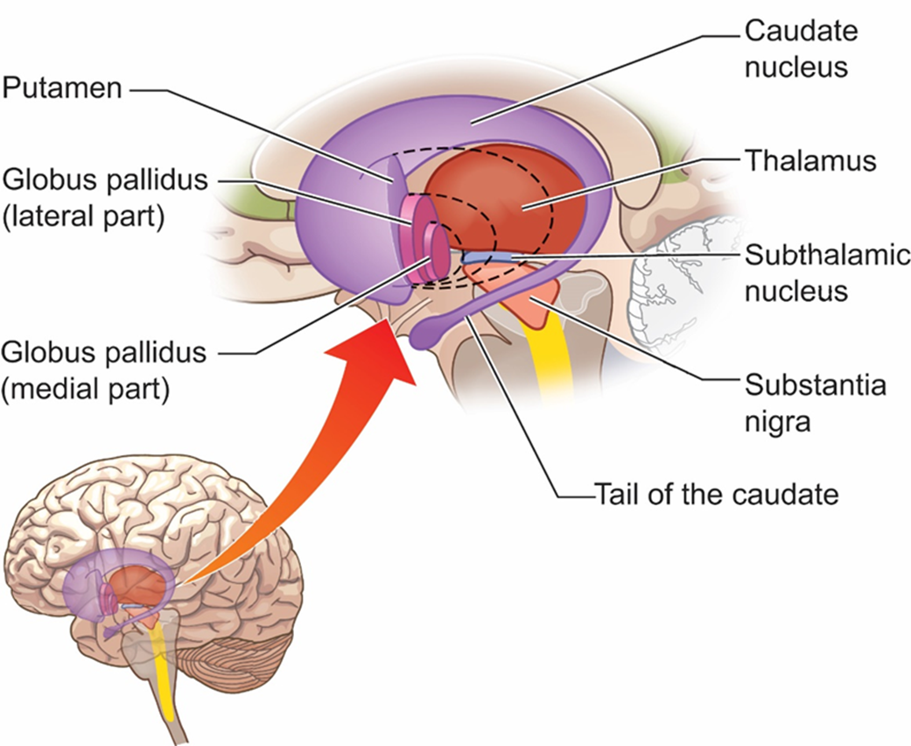
The Basal Ganglia
A collection of subcortical structures
  Striatum
    Dorsal: Caudate nucleus & Putamen (input zone)
    Ventral: nucleus accumbens (mostly non-motor functions)
  Globus Pallidus
    Internal Globus Pallidus (GPi)
    Globus pallidus external (GPe)
  Subthalamic nucleus
  Substantia Nigra?
    SN pars reticulata (SNr)
      The SNr and GP make up the Pallidum (output zone)
    SN pars compacta (SNc)

Slide 6
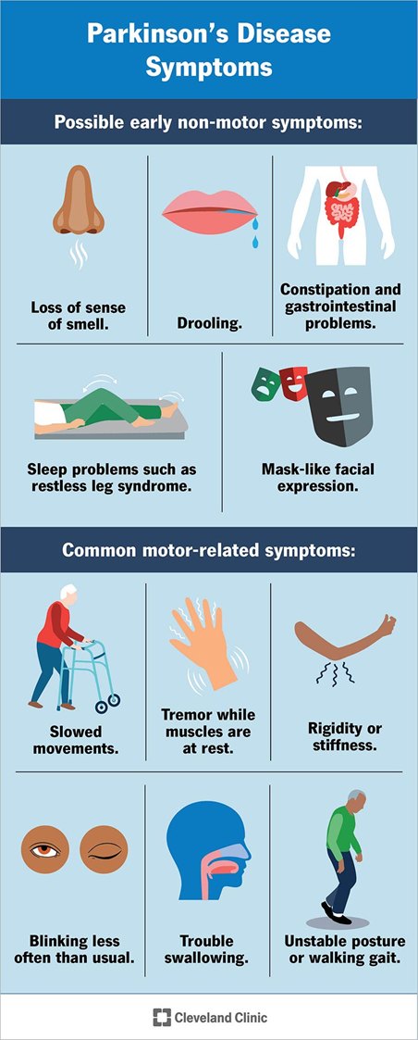
Parkinson’s Disease
A progressive neurodegenerative disorder that affects motor and sensory systems.
Common motor symptoms:
  Tremors
  Cogwheel rigidity
  Hypokinesia/bradykinesia
  Disturbance of posture
  Cognitive Dysfunction
Causes:
  Genetics
  Toxins, viruses, inflammation, stimulant abuse, or trauma.

Slide 7
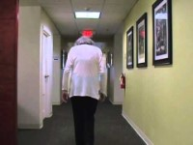
Parkinson’s Disease symptoms
https://www.youtube.com/watch?v=IHDFQfmkKlg
Notes:
Tremor: 40 sec
Akinesia, bradykinesia, posture and gait: 2 minutes
Rigidity: 3:50

Slide 8
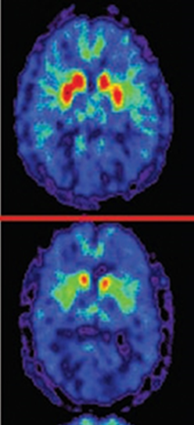
Parkinson’s disease:
Nervous system abnormalities
Large loss of dopaminergic neurons in the substantia nigra and ventral tegmental area.
Alterations in neural synchrony.
The mechanism that produces tremors is not clear
  Possible downstream effect of reduced cerebellar activity.
  Disruption of pathways between the cerebellum and the thalamus.
  Serotonin activity may be altered.
Notes:
Picture is PET with dopamine tracer. Top normal. Bottom PD

Slide 9
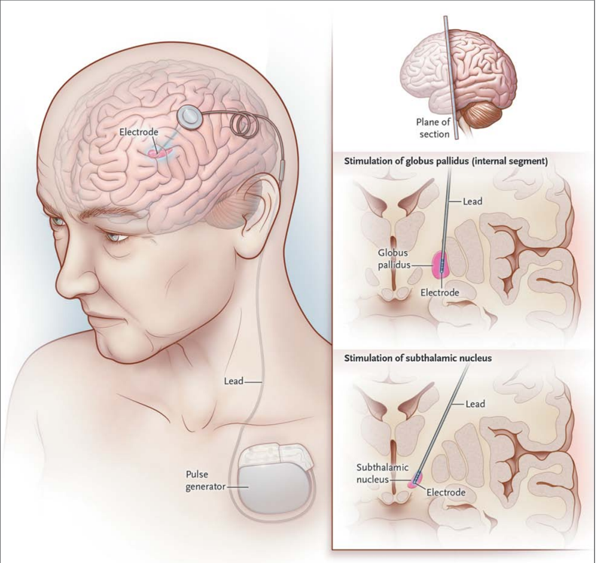
Parkinson’s disease:
Treatments
Dopamine agonist drugs
  Tends to be most effective, but effects are short-lived
Grafting brain tissue into the striatum
Intrastriatal delivery of growth factor
Thalatomy and/or pallidotomy.
Deep brain stimulation.
Behavioral Training
Okun, 2012

Slide 10
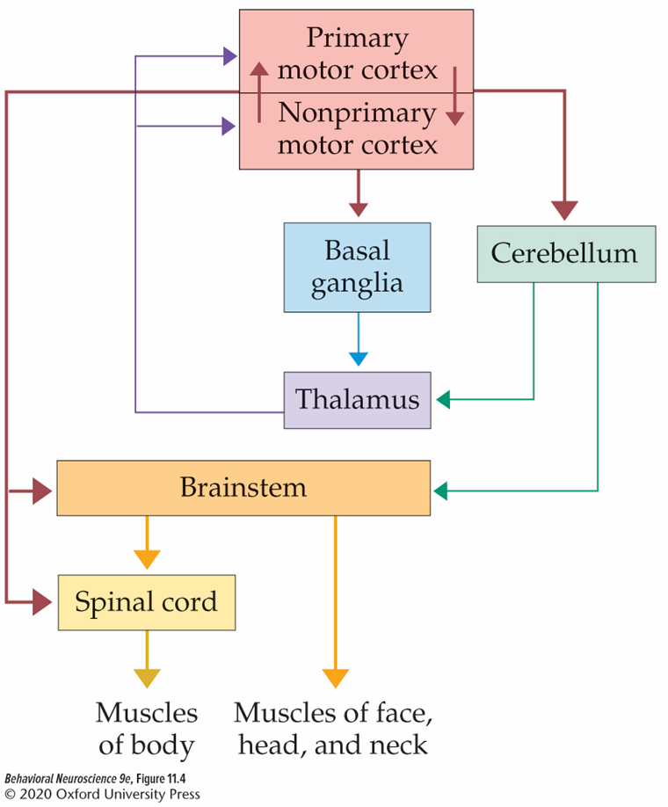
Basal Ganglia modulation of motor plans
Plays an important role in:
  Initiation and termination of movements.
  Enacting voluntary movements.
  Motor planning and learning, especially when there is motivational significance.

Slide 11
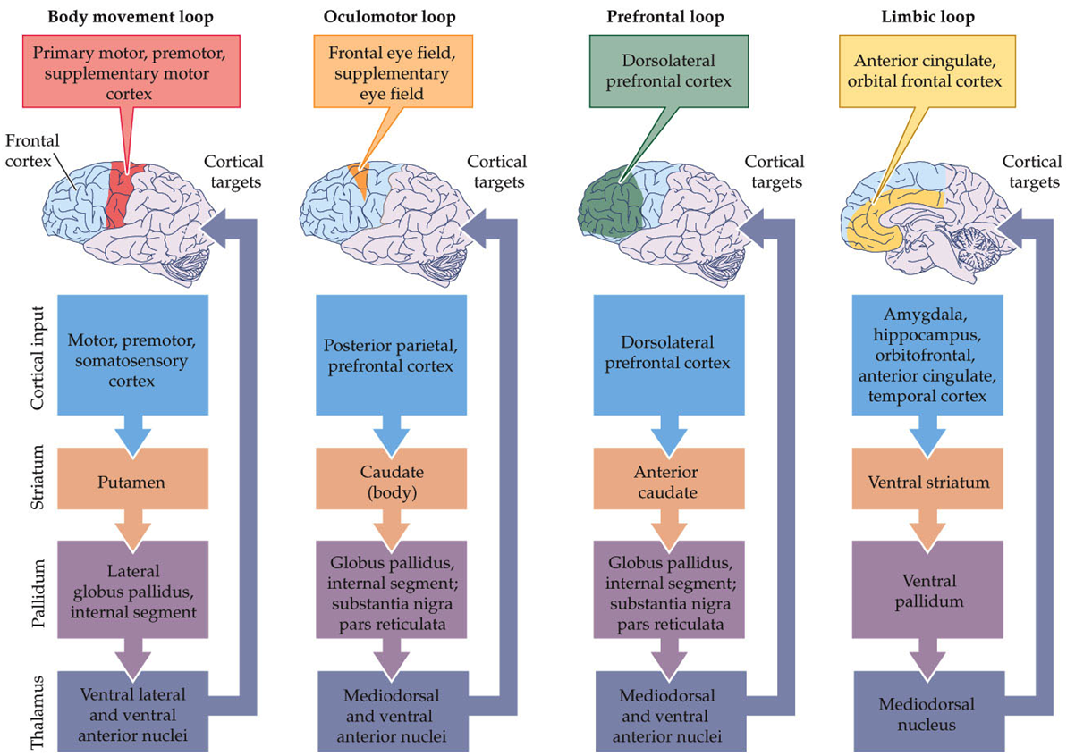
Basal Ganglia Cortex Feedback Loops
(aka corticostriatal pathway)

Slide 12
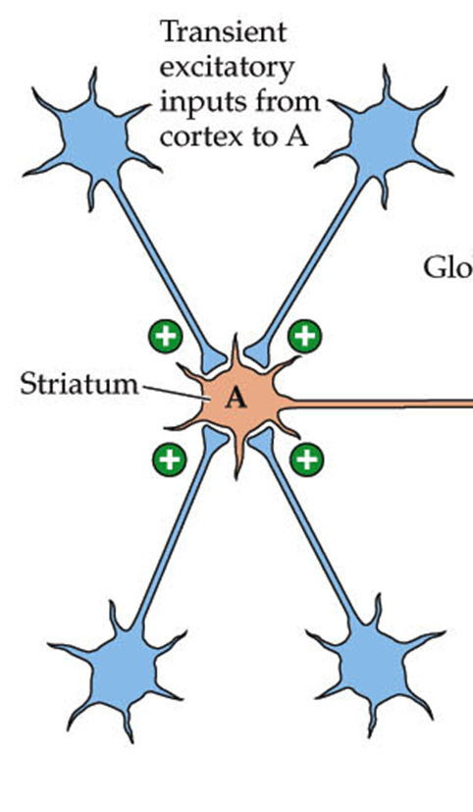
Corticostriatal projections
Glutamatergic (excitatory).
Synapse onto medium spiny neurons (MSNs) in the striatum.
Topographical organization.

Slide 13
Corticostriatal Projection Terminations
 | To the Caudate | To the Putamen | To the Nucleus Accumbens
Input from | multimodal association cortex | 1º & 2º somatic sensory & motor cortex | medial prefrontal cortex (mPFC)
Function | selection of movement | sensorimotor processing about movement | emotion, reward

Slide 14
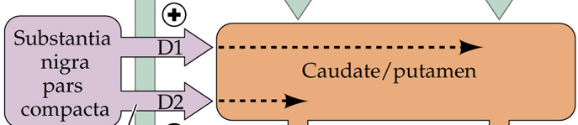
Substantia Nigra Inputs to BG
Substantia nigra pars compacta (SNc)
  DA-ergic neurons in the SNc project to the dorsal striatum.
    Striatal MSN have either D1 or D2 receptors

